Slide 2
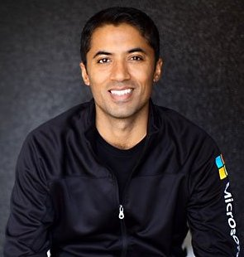
Build an Azure OpenAI powered .NET 8 Chat Bot on your data from scratch
Chander Dhall
CEO of Cazton
Microsoft RD/MVP
Google Developer Expert

Slide 3
Azure OpenAI vs OpenAI

Slide 4
Demo

Slide 5
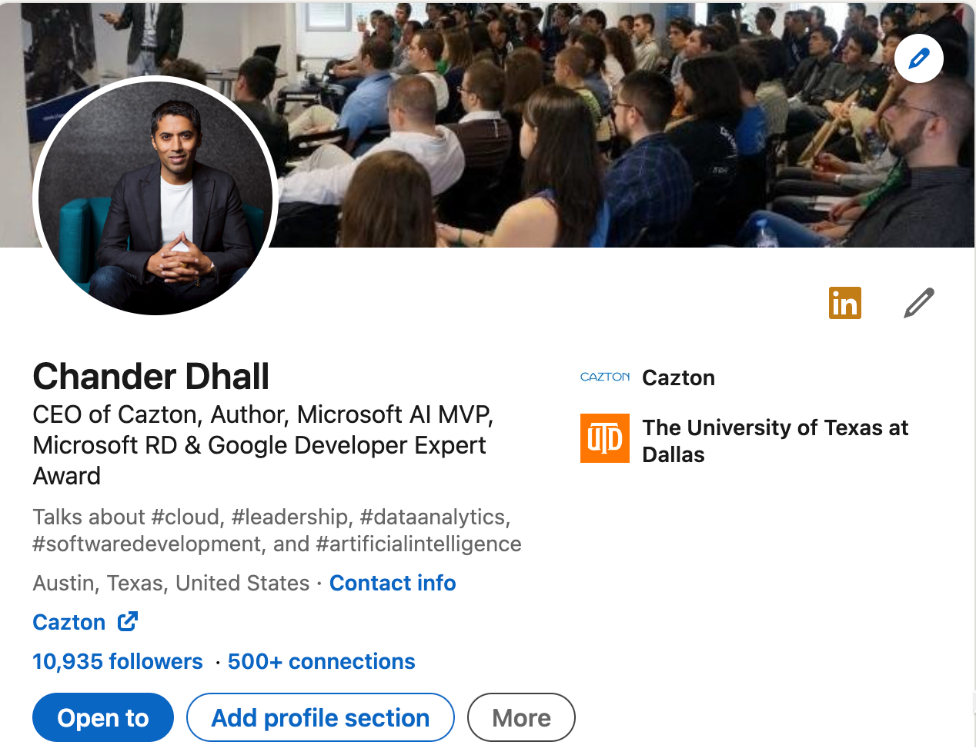
Connect: https://linkedin.com/in/CsDhall

Slide 6
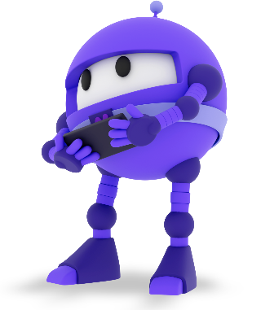
Resources
Download .NET 8 aka.ms/get-dotnet-8
Azure OpenAI https://aka.ms/azure-openai

